Slide 1
INSTANCE-BASED LEARNING
Dr. T. Adilakshmi
Professor, Dept of CSE

Slide 2
INSTANCE-BASED LEARNING
These methods simply store the training examples. Generalizing beyond these examples is postponed until a new instance must be classified.
Each time a new query instance is encountered, its relationship to the previously stored examples is examined in order to assign a target function value for the new instance.
Instance based learning includes nearest neighbor and locally weighted regression methods that assume instances can be represented as points in a Euclidean space. It also includes case-based reasoning methods that use, symbolic representations for instances.
Instance-based methods are sometimes referred to as "lazy" learning methods because they delay processing until a new instance must be classified.

Slide 3
Learning in these algorithms consists of simply storing the presented training data.
When a new query instance is encountered, a set of similar related instances is retrieved from memory and used to classify the new query instance.

Slide 4

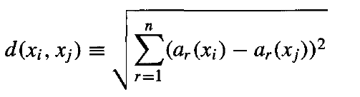
k-NEAREST NEIGHBOR LEARNING
The most basic instance-based method is the k-NEAREST NE IGHBOR algorithm. This algorithm assumes all instances correspond to points in the n-dimensional space
The nearest neighbors of an instance are defined in terms of the standard Euclidean distance.
let an arbitrary instance x be described by the feature vector
where ar(x) denotes the value of the rth attribute of instance x. Then the distance between two instances xi and xj is defined to be d(xi, xj), where
In nearest-neighbor learning the target function may be either discrete-valued or real-valued

Slide 5
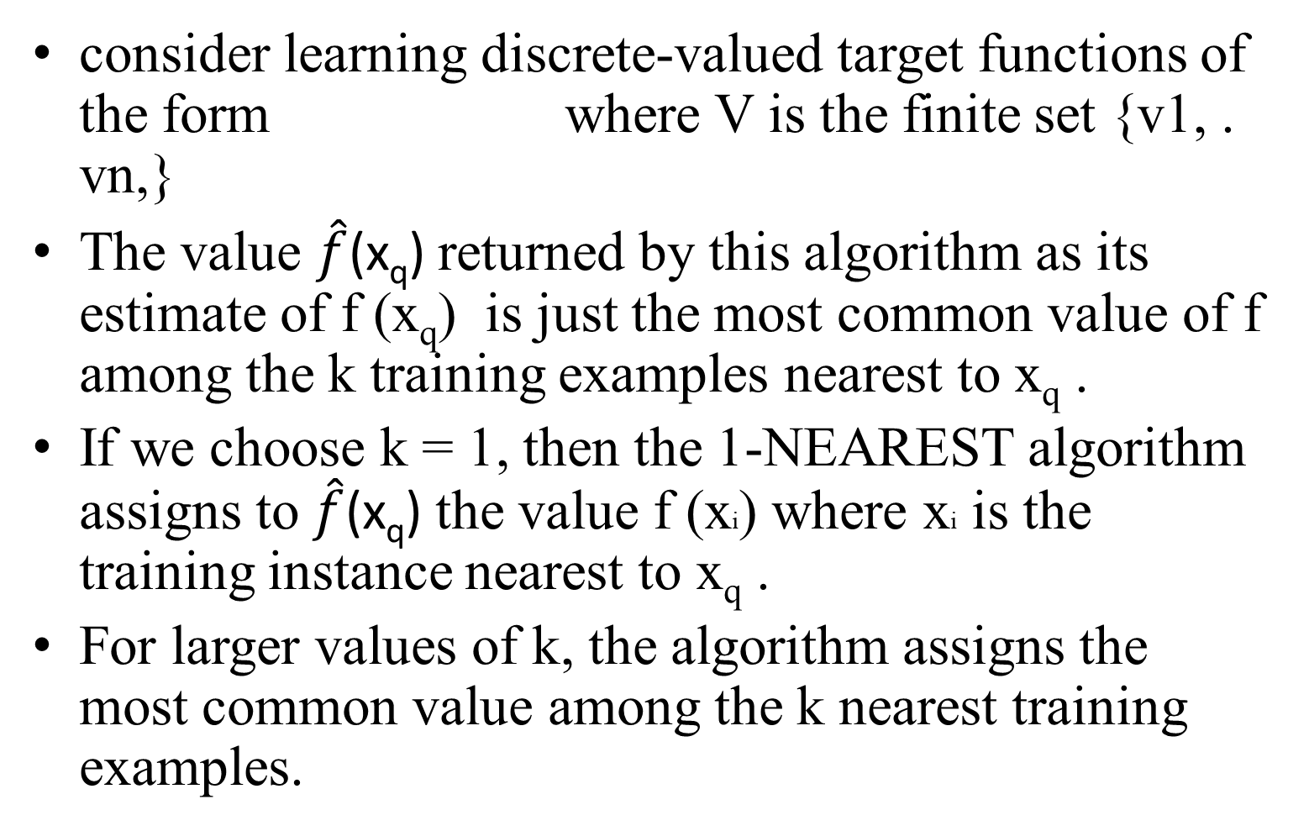

Slide 6
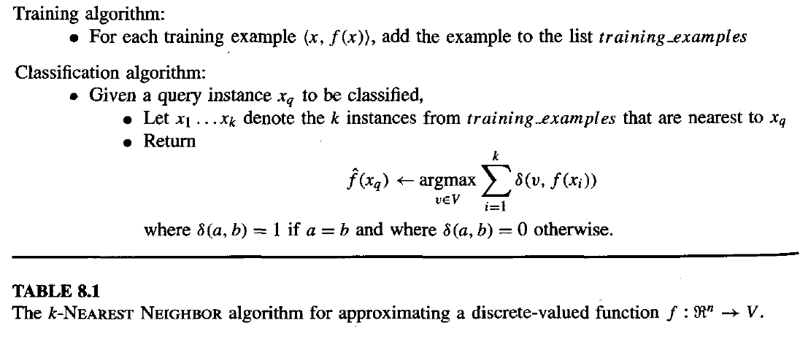
k-NEAREST NEIGHBOR LEARNING

Slide 7
Figure 8.1 - The instances are points in a two-dimensional space and where the target function is Boolean valued. The positive and negative training examples are shown by "+" and "-” respectively
1-Nearest learning algorithm classifies x_{q} as a positive example in this figure, whereas the 5-NEARESTE learning algorithm classifies it as a negative example.
the k-Nearest neighbor learning algorithm never forms an explicit general hypothesis regarding the target function f . It simply computes the classification of each new query instance as needed.

Slide 8
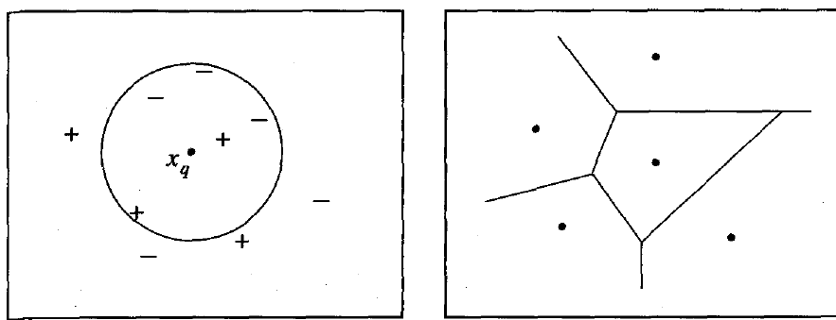
The diagram on the right side of Figure shows the shape of this decision surface induced by 1-Nearest Neighbor over the entire instance space.
The decision surface is a combination of convex polyhedra surrounding each of the training examples.
For every training example, the polyhedron indicates the set of query points whose classification will be completely determined by that training example.
Query points outside the polyhedron are closer to some other training example.
This kind of diagram is often called the Voronoi diagram of the set of training examples

Slide 9

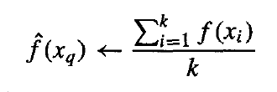
The KNN algorithm is easily adapted to approximating continuous-valued target functions.
To accomplish this, we have the algorithm calculate the mean value of the k nearest training examples rather than calculate their most common value.
To approximate a real-valued target function
we replace the final line of the algorithm by

Slide 10
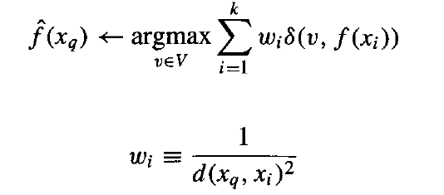
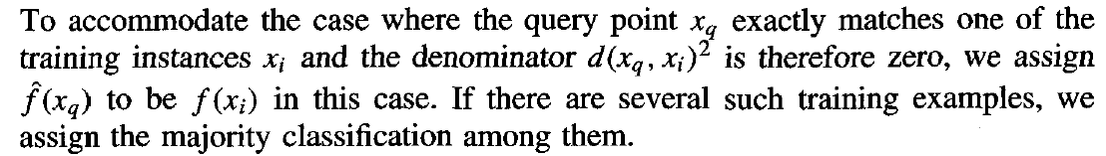
Distance-Weighted Nearest Neighbor algorithm
Refinement to the Nearest Neighbor algorithm is to weight the contribution of each of the k neighbors according to their distance to the query point x_{q} giving greater weight to closer neighbors
This can be accomplished by replacing the final line of the algorithm by

Slide 11
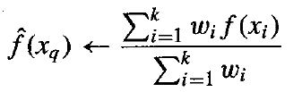
for real-valued target functions
the denominator in Equation (8.4) is a constant that normalizes the contributions of the various weights
The only disadvantage of considering all examples is that our classifier will run more slowly. If all training examples are considered when classifying a new query instance, we call the algorithm a global method.
If only the nearest training examples are considered, we call it a local method.

Slide 12
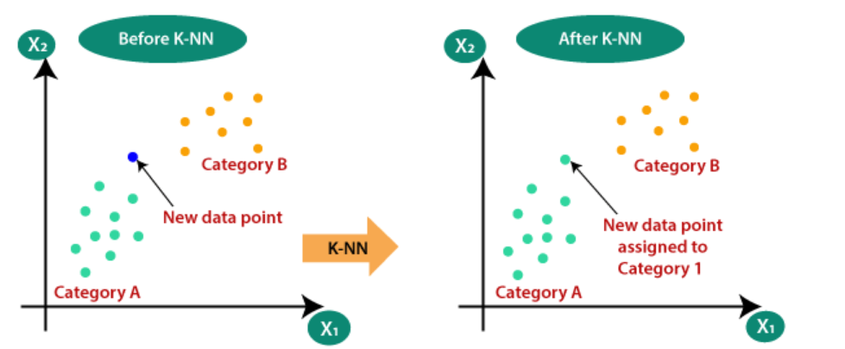

Slide 13
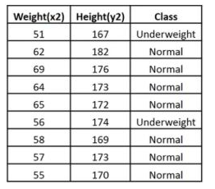



Slide 14
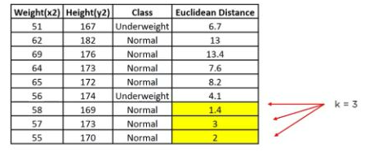



Slide 15
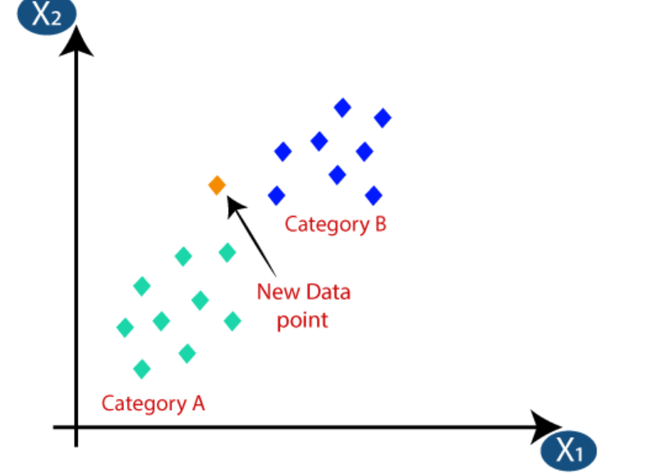

Slide 16
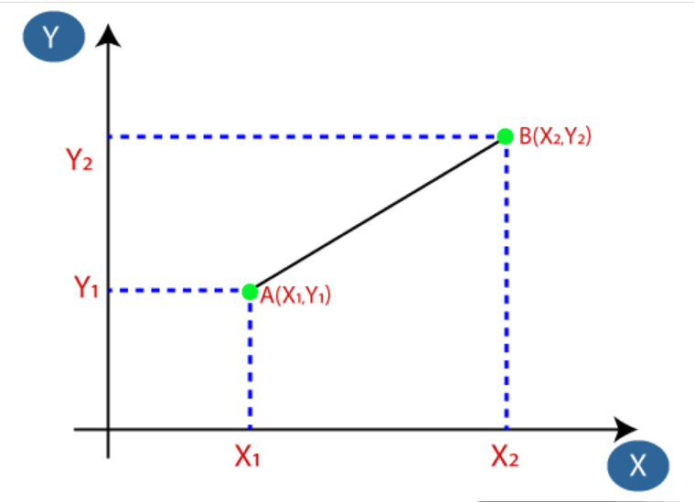

Slide 17
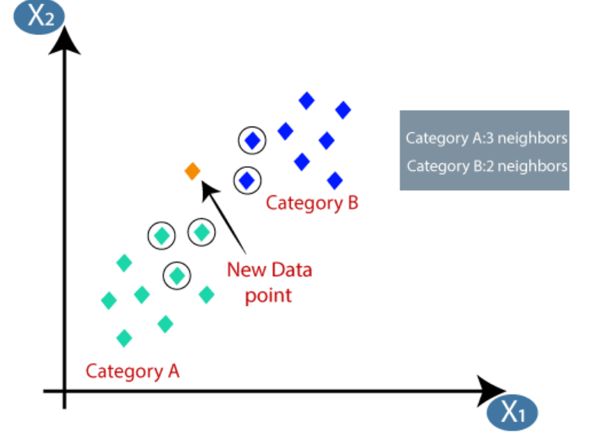
As we can see the 3 nearest neighbors are from category A, hence this new data point must belong to category A.

Slide 18
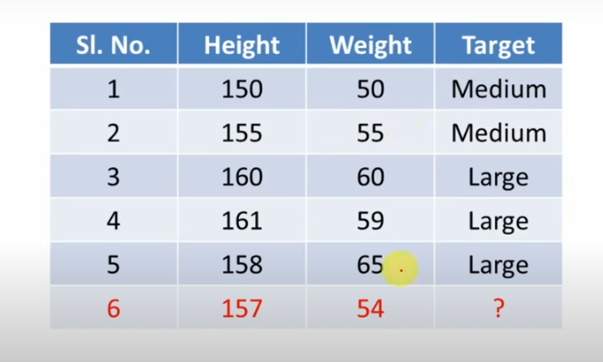

Slide 19
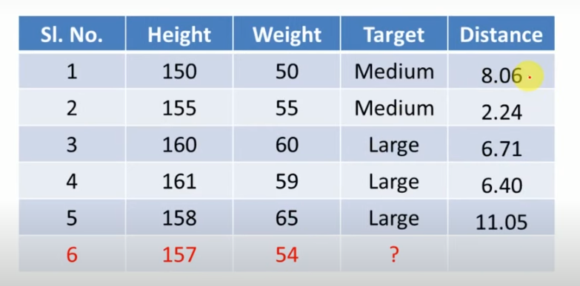

Slide 20
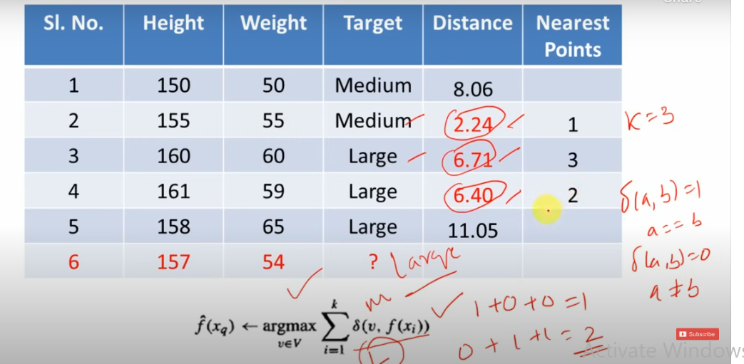

Slide 21
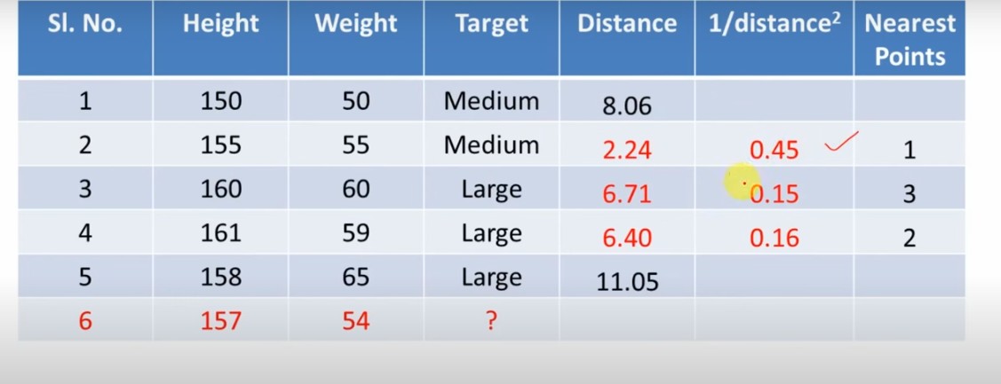

Slide 22
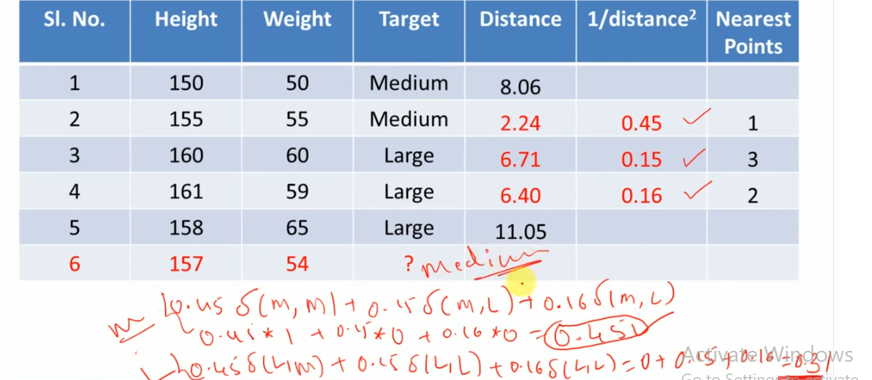

Slide 23
Terminology
Much of the literature on nearest-neighbor methods and weighted local regression uses a terminology that has arisen from the field of statistical pattern recognition.
it is useful to know the following terms:
Regression means approximating a real-valued target function.
Residual is the error (x) - f (x) in approximating the target function.
Kernel function is the function of distance that is used to determine the weight of each training example.
the kernel function is the function K such that w_{i} = K(d(x_{i}, x_{q})).

Slide 24
LOCALLY WEIGHTED REGRESSION
The nearest-neighbor approaches described in the previous section can be thought of as approximating the target function f(x) at the single query point x = x_{q}
Locally weighted regression is a generalization of this approach. It constructs an explicit approximation to f over a local region surrounding x_{q}

Slide 25
For example, we might approximate the target function in the neighborhood surrounding x_{q} using a linear function, a quadratic function, a multilayer neural network, or some other functional form.
The phrase "locally weighted regression" is called local because the function is approximated based only on data near the query point,
weighted because the contribution of each training example is weighted by its distance from the query point,
and regression because this is the term used widely in the statistical learning community for the problem of approximating real-valued functions.

Slide 26
Given a new query instance x_{q} the general approach in locally weighted regression is to construct an approximation that fits the training examples in the neighborhood surrounding x_{q}.
This approximation is then used to calculate the value (x_{q}), which is output as the estimated target value for the query instance.
The description of may then be deleted, because a different local approximation will be calculated for each distinct query instance.

Slide 27

Locally Weighted Linear Regression
Consider the case of locally weighted regression in which the target function f is approximated near x_{q} using a linear function of the form
Where a_{i}(x) denotes the value of the i^{th} attribute of the instance x.
In gradient descent find the coefficients w₀ . . . w_{n} to minimize the error in fitting such linear functions to a given set of training examples using a global approximation to the target function. Therefore, we derived methods to choose weights that minimize the squared error summed over the set D of training examples.

Slide 28


Gradient descent training rule
where ⴄ is a constant learning rate

Slide 29
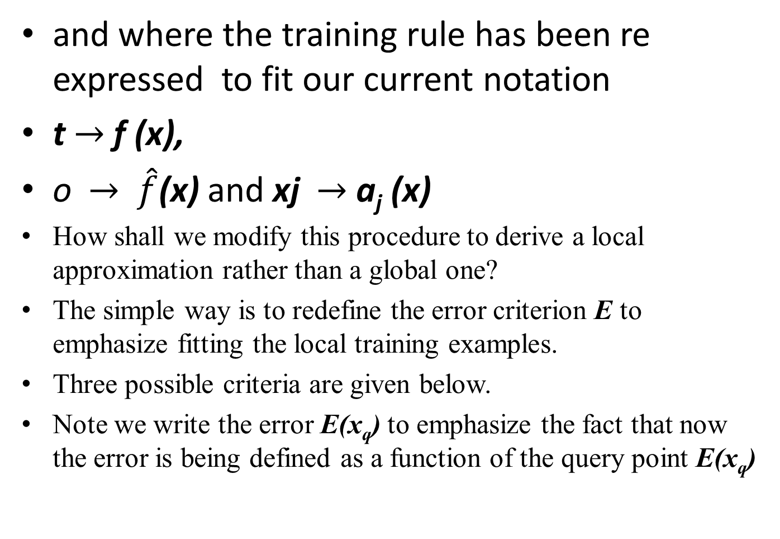
and where the training rule has been re expressed to fit our current notation
t $→$ f (x),
o $→$ $\hat{f}$(x) and xj $→$ a_{j} (x)
How shall we modify this procedure to derive a local approximation rather than a global one?
The simple way is to redefine the error criterion E to emphasize fitting the local training examples.
Three possible criteria are given below.
Note we write the error E(x_{q}) to emphasize the fact that now the error is being defined as a function of the query point E(x_{q})

Slide 30
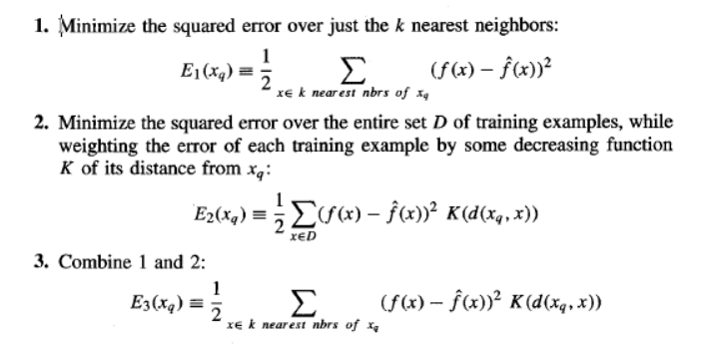
To derive the Local Approximation

Slide 31

If we choose criterion three above and re-derive the gradient descent rule, we obtain the following training rule.
Contribution of instance x to the weight update is now multiplied by the distance penalty K(d(x_{q}, x)), and that the error is summed over only the k nearest training examples.

Slide 32
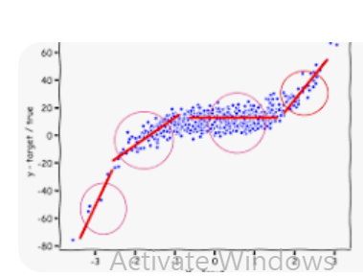

Slide 33
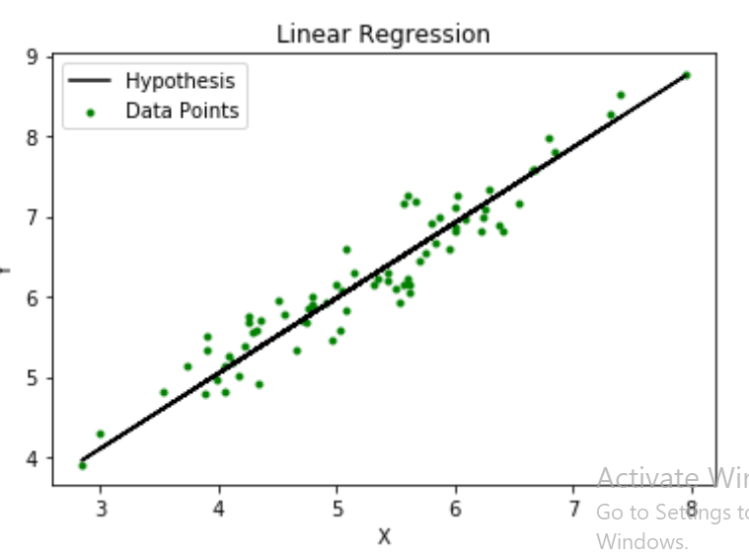

Slide 34
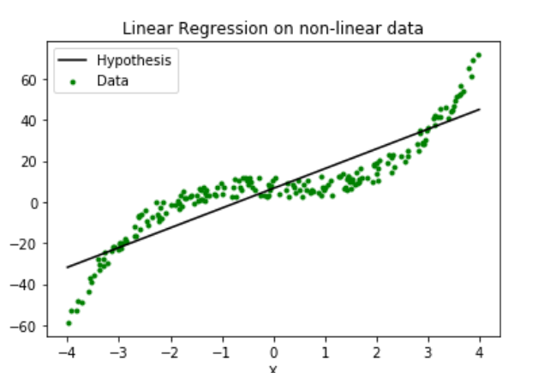

Slide 35
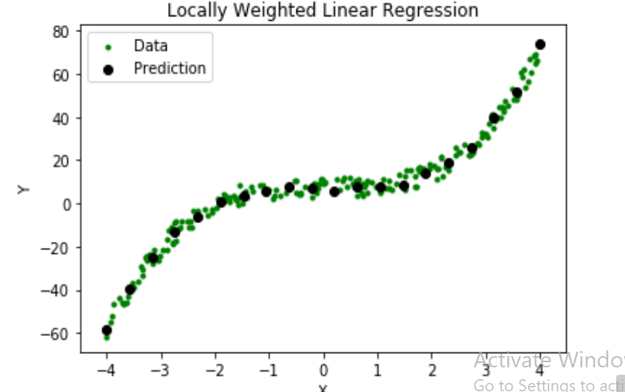

Slide 36

RADIAL BASIS FUNCTIONS
One approach to function approximation that is closely related to distance-weighted regression and also to artificial neural networks is learning with radial basis functions
The learned hypothesis is a function of the form
Where each x_{u} is an instance from X and where the kernel function K_{u}(d(x_{u}, x)) is defined so that it decreases as the distance d(x_{u}, x) increases. Here k is a user provided constant that specifies the number of kernel functions to be included.

Slide 37




is a global approximation to f (x), the contribution from each of the terms is localized to a region nearby the point x_{u}.
It is common to choose each function
to be a Gaussian function centered at the point x_{u} with some variance
The function can be viewed as describing a two layer network where the first layer of units computes the values of the various and where the second layer computes a linear combination of these first-layer unit values.

Slide 38
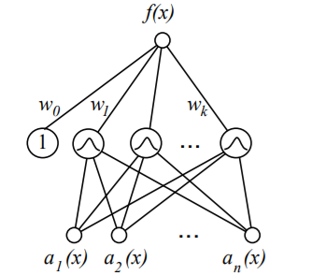
Each hidden unit produces an activation determined by a Gaussian function centered at some instance x_{u}. Therefore, its activation will be close to zero unless the input x is near x_{u}. The output unit produces a linear combination of the hidden unit activations.

Slide 39
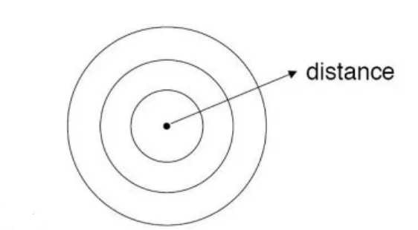
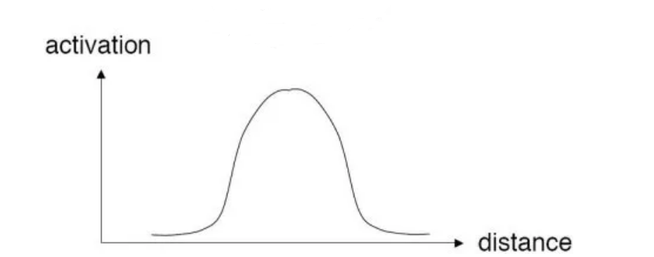
Radial distance
Gaussian Radial Function

Slide 40
Given a set of training examples of the target function, RBF networks are typically trained in a two-stage process.
First, the number k of hidden units is determined and each hidden unit u is defined by choosing the values of x_{u} and
That define its kernel function
Second, the weights w_{u} are trained to maximize the fit of the network to the training data, using the global error criterion.

Slide 41


Given this approach, the RBF network learns a global approximation to the target function in which each training example (x_{i}, f (x_{i})) can influence the value of only in the neighborhood of x_{i}.
One advantage of this choice of kernel functions is that it allows the RBF network to fit the training data exactly. That is, for any set of m training examples the weights w_{o} . . . w_{n} for combining the m Gaussian kernel functions can be set so
that for each training example (x_{i}, f (x_{i}))

Slide 42
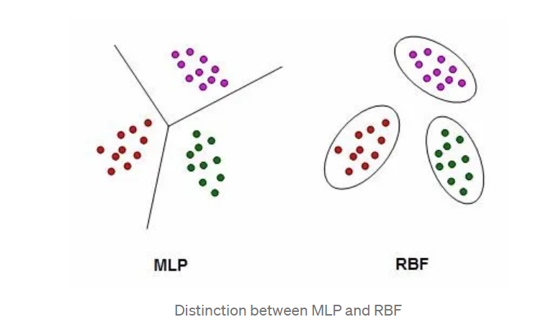

Slide 43
CASE-BASED REASONING
Instance-based methods such as K-NN, locally weighted regression share three key properties.
First, they are lazy learning methods
Second, they classify new query instances by analyzing similar instances while ignoring instances that are very different from the query.
Third, they represent instances as real-valued points in an n-dimensional Euclidean space
Case-based reasoning (CBR) is a learning paradigm based on the first two of these principles, but not the third

Slide 44
In CBR, instances are typically represented using more rich symbolic descriptions.
CBR has been applied to problems such as conceptual design of mechanical devices based on a stored library of previous designs, reasoning about new legal cases based on previous rulings, and solving planning and scheduling problems by reusing and combining portions of previous solutions to similar problems.

Slide 45
Example, The CADET system employs case based reasoning to assist in the conceptual design of simple mechanical devices such as water faucets.
It uses a library containing approximately 75 previous designs and design fragments to suggest conceptual designs to meet the specifications of new design problems.
Each instance stored in memory (water pipe) is represented by describing both its structure and its qualitative function. New design problems are then presented by specifying the desired function and requesting the corresponding structure

Slide 46
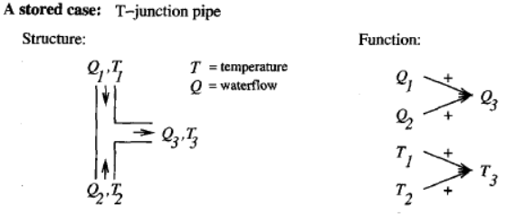
figure shows the description of a typical stored case called a T-junction pipe. Its function is represented in terms of the qualitative relationships among the water flow levels and temperatures at its inputs and outputs

Slide 47
In the functional description at its right, an arrow with a "+" label indicates that the variable at the arrowhead increases with the variable at its tail.
For example, the output waterflow Q₃ increases with increasing input waterflow Q_{l}, a "-" label indicates that the variable at the head decreases with the variable at the tail

Slide 48
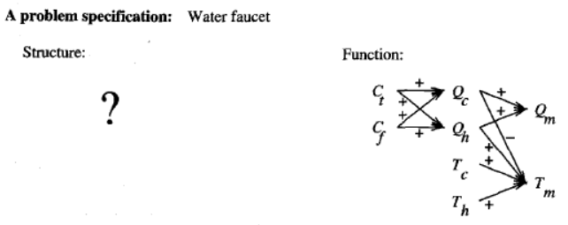
This particular function describes the required behavior of one type of water faucet. Here Q_{c}, refers to the flow of cold water into the faucet, Q_{h} to the input flow of hot water, and Q_{m}, to the single mixed flow out of the faucet. Similarly, T_{c}, T_{h}, and T_{m}, refer to the temperatures of the cold water, hot water, and mixed water respectively. The variable C_{t} denotes the control signal for temperature that is input to the faucet, and C_{f} denotes the control signal for waterflow.

Slide 49
Given this functional specification for the new design problem, CADET searches its library for stored cases whose functional descriptions match the design problem. If an exact match is found, indicating that some stored case implements exactly the desired function, then this case can be returned as a suggested solution to the design problem.
If no exact match occurs, CADET may find cases that match various subgraphs of the desired functional specification
The T-junction function matches a subgraph of the water faucet function graph.

Slide 50
CADET searches for subgraph isomorphisms between the two function graphs, so that parts of a case can be found to match parts of the design specification. Furthermore, the system may elaborate the original function specification graph in order to create functionally equivalent graphs that may match still more cases.

Slide 51
LAZY AND EAGER LEARNING
lazy learning methods: the k-NN algorithm, locally weighted regression, and case-based reasoning.
The key difference between lazy and eager methods in this regard is
Lazy methods may consider the query instance x_{q} when deciding how to generalize beyond the training data D.
Eager methods cannot. By the time they observe the query instance x_{q} they have already chosen their (global) approximation to the target function.

